Slide 1
DEVELOPMENT OF AN ONLINE SPACE MEDICINE COURSE FOR MEDICAL STUDENTS TO INCREASE THEIR ACCESSIBILITY TO THIS FIELD
T. Girgla^{1,5}; R. Ferguson^{2,5}; P. Anand^{3,5}; N. Girgla^{1,5}; J. Bagian⁴
¹University of Michigan Medical School, ²University of Cincinnati College of Medicine, ³University of Kentucky College of Medicine, ⁴Anesthesiologist and ex-NASA Astronaut, ⁵AMSRO
BACKGROUND: To date, only a handful of medical schools and institutions offer formal Space Medicine courses despite the rapid growth of the field. Due to this limited accessibility, many students remain unaware of the field, and interested students face difficulty gaining academic exposure - a critical issue for AsMA attendees to address now. Thus, we endeavored to create a readily adaptable two-week online aerospace medicine course to address this gap in medical education.
OVERVIEW: The two-week online course consists of ten modules (full list next slide) covering topics adapted from:
Fundamentals of Space Medicine by Clement
Space Physiology by Buckey and
Space Physiology and Medicine by Nicogossian.

Slide 2
DEVELOPMENT OF AN ONLINE SPACE MEDICINE COURSE FOR MEDICAL STUDENTS TO INCREASE THEIR ACCESSIBILITY TO THIS FIELD
T. Girgla^{1,5}; R. Ferguson^{2,5}; P. Anand^{3,5}; N. Girgla^{1,5}; J. Bagian⁴
¹University of Michigan Medical School, ²University of Cincinnati College of Medicine, ³University of Kentucky College of Medicine, ⁴Anesthesiologist and ex-NASA Astronaut, ⁵AMSRO
Each module contains readings, PowerPoint presentations with integrated clinical cases, quizzes, and supplementary assignments (consisting of journal articles, videos, podcasts, etc). The course also includes a pre-and post-course assessment and a list of further readings, opportunities, and resources.
Module 1: Introduction and Historical Perspectives
Module 2: Operational and Life Support Systems in Space
Module 3: Preflight and Postflight Recovery
Module 4: Radiation in Space
Module 5: Neuro-Vestibular System in Space
Module 6: Vision in Space
Module 7: Cardiopulmonary System in Space
Module 8: Musculoskeletal System in Space
Module 9: Psychological Considerations in Space
Module 10: Nutrition in Space

Slide 3
DEVELOPMENT OF AN ONLINE SPACE MEDICINE COURSE FOR MEDICAL STUDENTS TO INCREASE THEIR ACCESSIBILITY TO THIS FIELD
T. Girgla^{1,5}; R. Ferguson^{2,5}; P. Anand^{3,5}; N. Girgla^{1,5}; J. Bagian⁴
¹University of Michigan Medical School, ²University of Cincinnati College of Medicine, ³University of Kentucky College of Medicine, ⁴Anesthesiologist and ex-NASA Astronaut, ⁵AMSRO
This course structure successfully provides students an introductory exposure to space medicine and career possibilities within it. The course has been formalized at the University of Michigan Medical School, and it is also set to launch at the University of Cincinnati in Jan 2022. The qualitative and quantitative data categories that have been gathered include 1) Knowledge Gained (100% of students) 2) Course Satisfaction (100% of students) 3) Course Influence on Future Goals (>50% of students) and 4) Quality Improvement/Program Evaluation.
DISCUSSION: This introductory, online aerospace medicine course will fill a gap in medical education and make the field more accessible to interested students - thus recruiting young talent to advance the field of space medicine. Next steps include 1) incorporating students’ and subject-matter experts’ feedback into the class and 2) piloting the course at other medical schools. Future directions include making the elective widely available online to support students across international and civilian/military spheres.

Slide 4
BACKGROUND

Slide 5
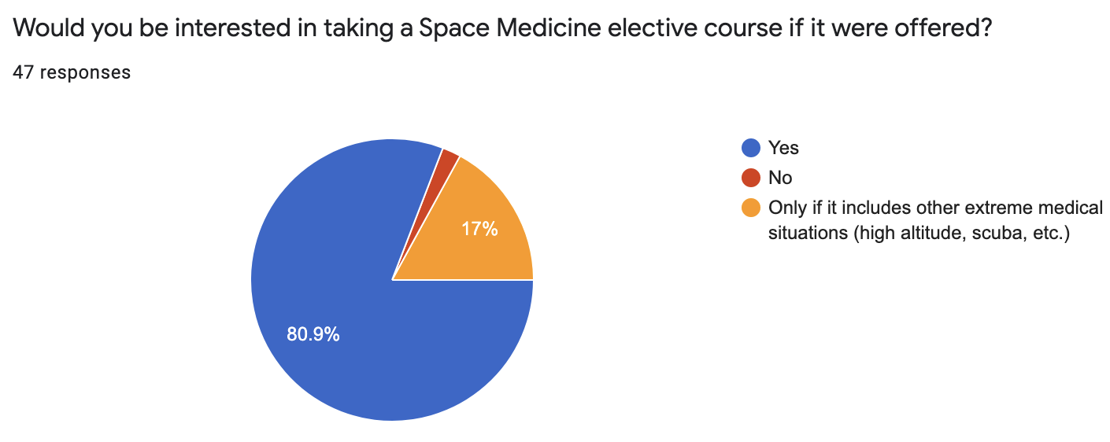
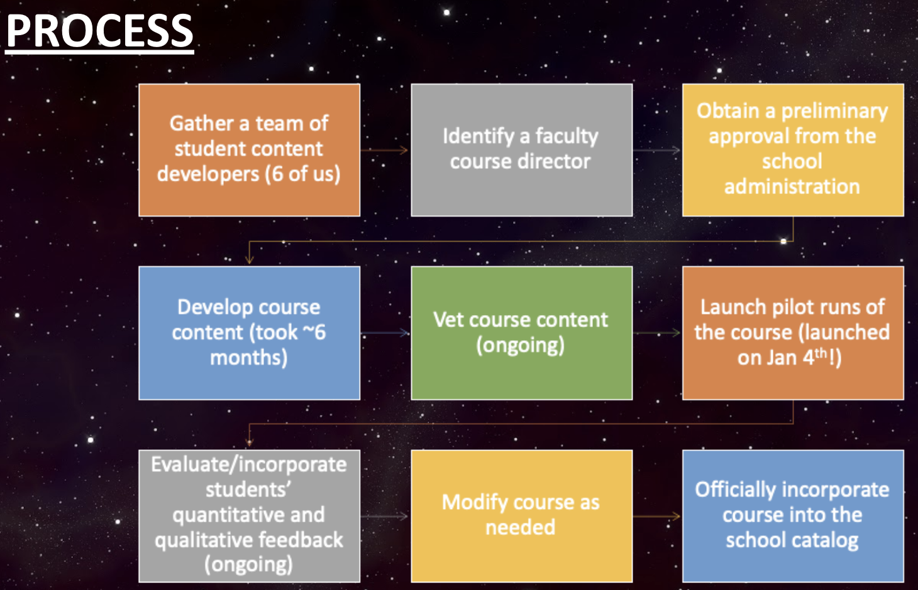
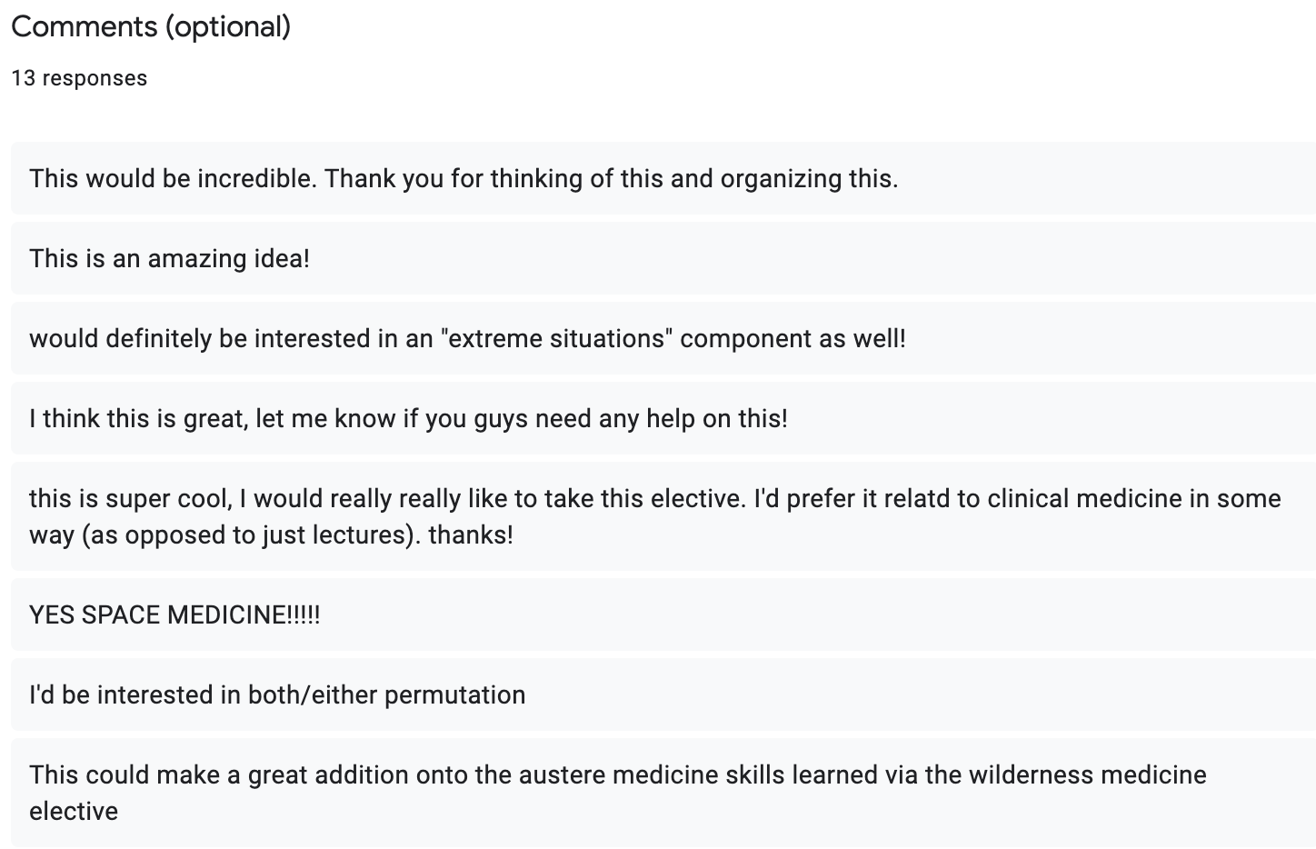
METHODS
NEEDS ASSESSMENT
PROCESS

Slide 6
METHODS

Slide 7
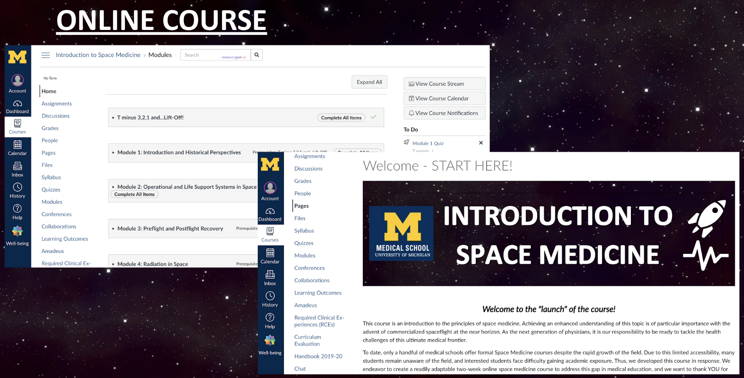
OVERVIEW

Slide 8
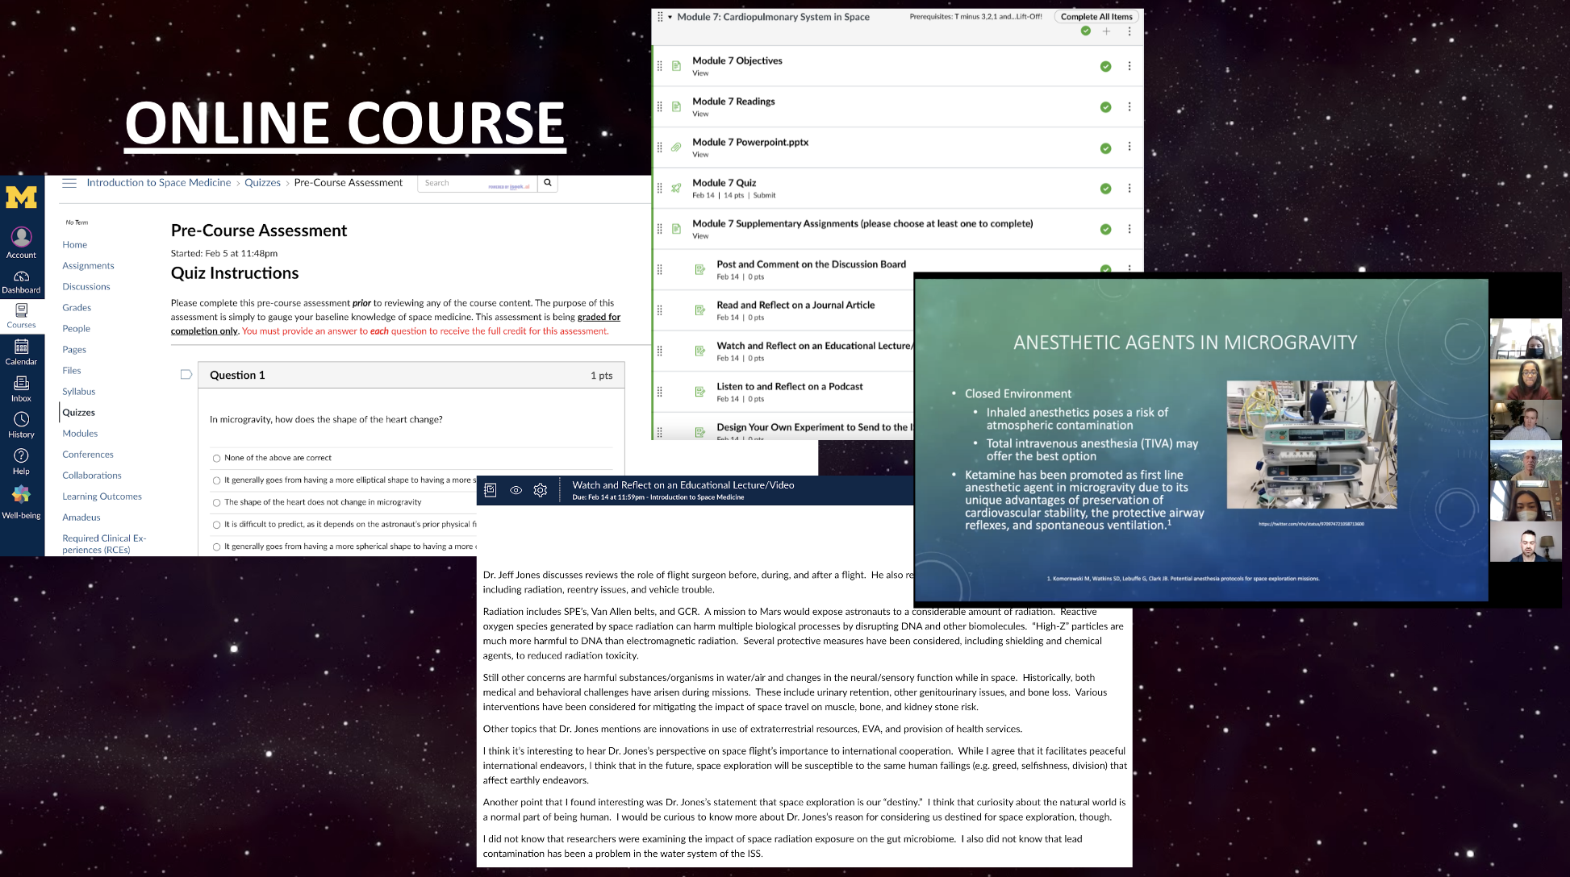
OVERVIEW

Slide 9
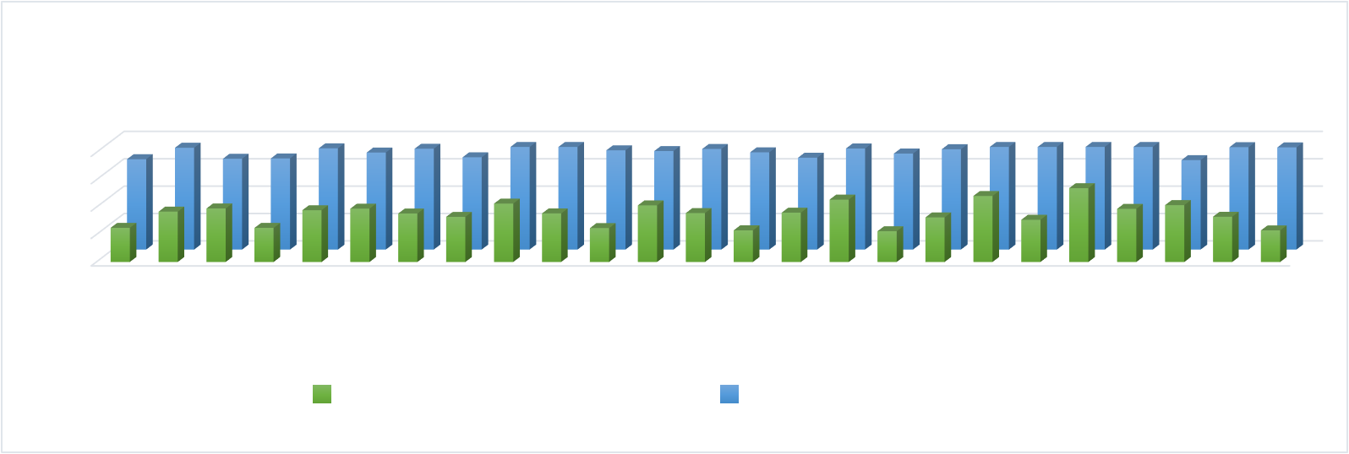
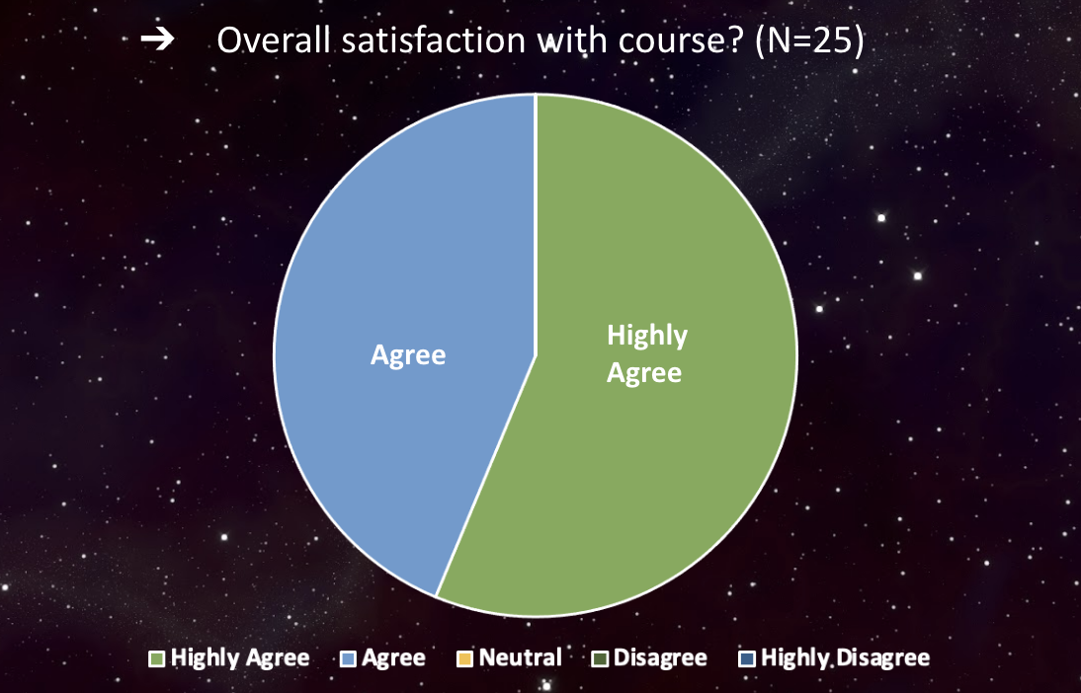
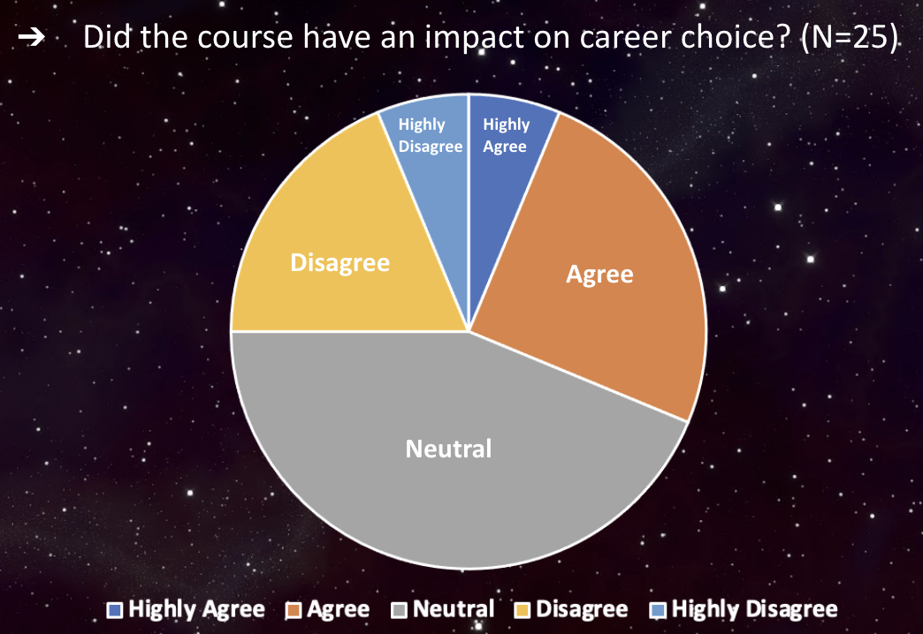
RESULTS - Quantitative

Slide 10
RESULTS - Quantitative

Slide 11
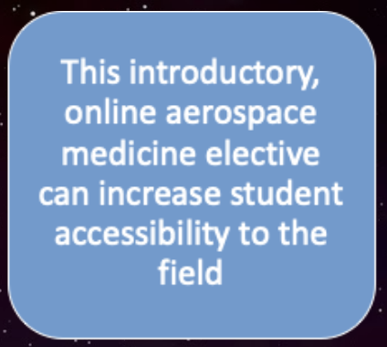
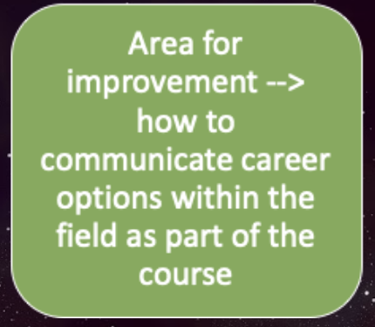
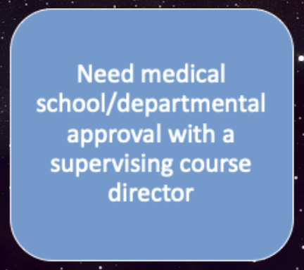
DISCUSSION
CONCLUSIONS
LIMITATIONS
NEXT STEPS:

Slide 12
REFERENCES

